Slide 1
Big Mountain Resort
Pricing Model

Slide 2
Context
Big Mountain is a ski resort located in Montana. It offers spectacular views of nearby national parks and has access to 105 trails and has 11 lifts. They accommodate skiers and riders of all levels and about 350,000 people ski there every year. They installed additional chairlift to increase the distribution of visitors leading to increase in costs by $1.54M. The resort is seeking ways to cut the cost and maintain profits by winter 2021.

Slide 3
Problem Statement
Success criteria
How can Big Mountain Resort select a better ticket price for the Winter 2021 and make other changes to cut the increased costs of $1.54M and maintain profits.
To reduce the operational costs without undermining the ticket price and maintain profits by the end of the season 2021.

Slide 4
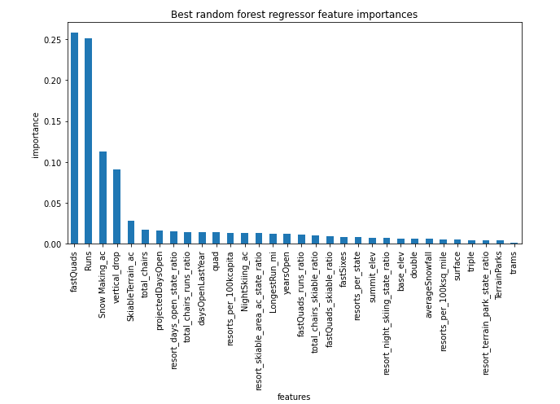
Key Features affecting ticket price:
fast Quads
Runs
Snow Making area
Vertical drop

Slide 5
Key findings/Recommendations:
Predicted ticket price - $95 , originally $81.
Facilities that support the ticket-price:
If Big Mountain is adding a run, increasing the vertical drop by 150 feet, and installing an additional chair lift, it would increase support for ticket price by $1.99.Over the season, this could be expected to amount to $3474638.

Slide 6
Modeling insights: scenarios
Close up to 10 of the least used runs..
adding a run, increasing the vertical drop by 150 feet, and installing an additional chair lift
adding a run, increasing the vertical drop by 150 feet, installing an additional chair lift and 2 acres of snow-making.
increase the longest run by .2 miles and guaranteeing its snow coverage by adding 4 acres of snow making capability.

Slide 7
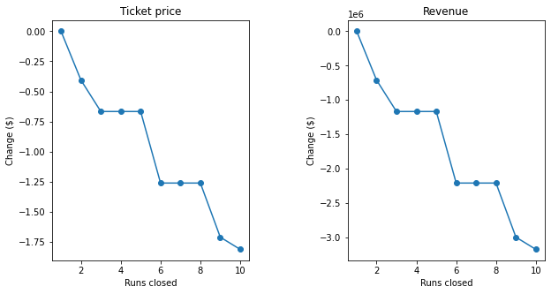
Modeling insights: scenarios
Effect of closing runs on ticket price and revenue

Slide 8
Conclusion
Overall Scenario 2 is suggested, as it clearly offsets the cost of installing 1 new chair lift (~$1.54M).
Closing 1 run makes no difference on the ticket price,however money saved from maintenance for closed run should be incorporated into the data to understand how it may benefit the ticket price.

